Slide 1
About next week …

Slide 2
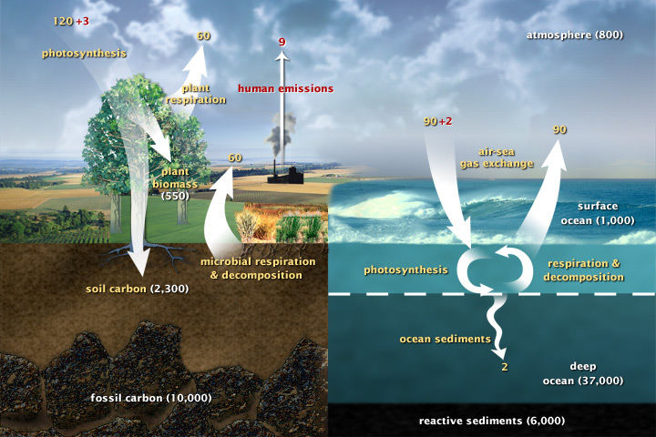
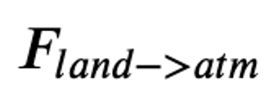
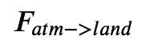
Where does all the carbon go?

Slide 3

Think about this taking place in discrete time steps, $∆t$

Slide 4
Think about this taking place in discrete time steps, ∆𝒕
Net flux between land & atmosphere: GtC/year

Slide 5
Think about this taking place in discrete time steps, ∆𝒕
Net flux between land & atmosphere: GtC/year
Time interval (years) for each step in series of steps: years/step

Slide 6
Think about this taking place in discrete time steps, ∆𝒕
Net flux between land & atmosphere: GtC/year
Time interval (years) for each step in series of steps: years/step
The change in the concentration of carbon in the atmosphere for that step.

Slide 7
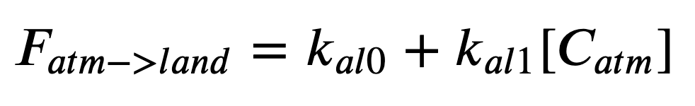
Think about this taking place in discrete time steps, ∆𝒕
This is a little different from last time:

Slide 8
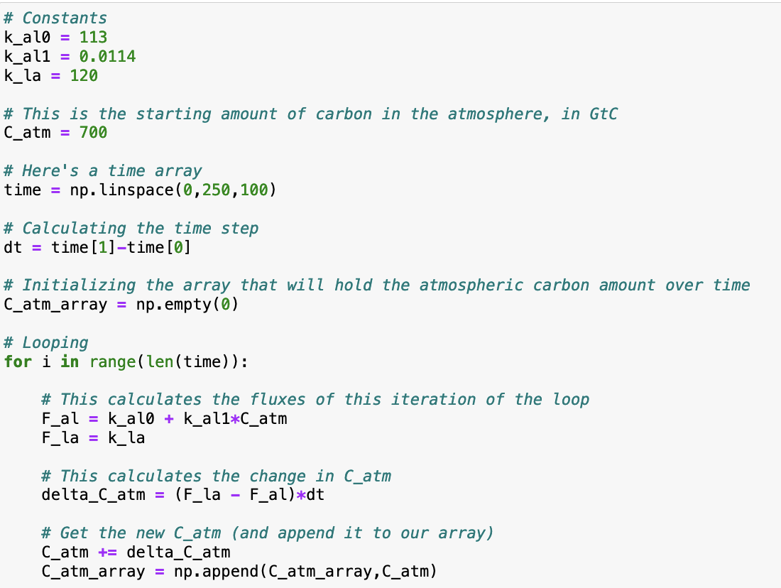
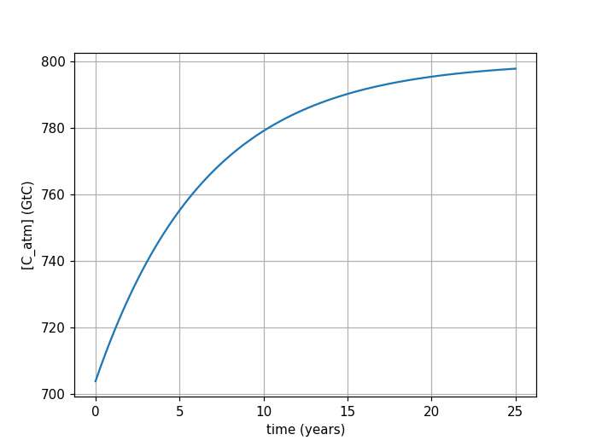
A “for loop” lets us repeat this for a desired number of steps
Start with 700 GtC in the atmosphere

Slide 9
A “for loop” lets us repeat this for a desired number of steps
Make an array of times

Slide 10
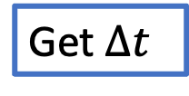
A “for loop” lets us repeat this for a desired number of steps
Get $∆t$

Slide 11
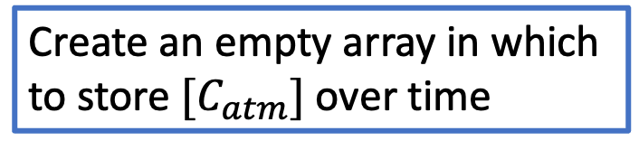
A “for loop” lets us repeat this for a desired number of steps
Create an empty array in which to store $[C_{atm}]$ over time

Slide 12
A “for loop” lets us repeat this for a desired number of steps
Start the “for loop”

Slide 13
A “for loop” lets us repeat this for a desired number of steps
Get fluxes into/out of the atmosphere during this step

Slide 14
A “for loop” lets us repeat this for a desired number of steps
Get fluxes into/out of the atmosphere during this step*
*Flux out of the atmosphere obeys 1st-order kinetics; flux in is just a constant.

Slide 15

A “for loop” lets us repeat this for a desired number of steps
Get $∆\left[C_{atm}\right]$ for this step

Slide 16

A “for loop” lets us repeat this for a desired number of steps
Increase $\left[C_{atm}\right]$ by $∆\left[C_{atm}\right]$

Slide 17
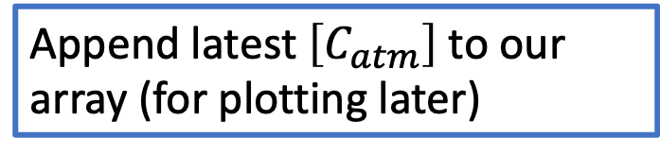
A “for loop” lets us repeat this for a desired number of steps
Append latest $\left[C_{atm}\right]$ to our array (for plotting later)

Slide 18
A “for loop” lets us repeat this for a desired number of steps
Append latest $\left[C_{atm}\right]$ to our array (for plotting later)
This algorithm is called Euler’s Method

Slide 19
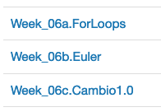
CGIs this week

